Slide 1
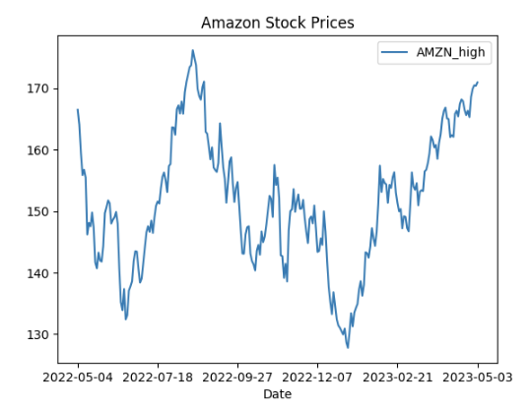
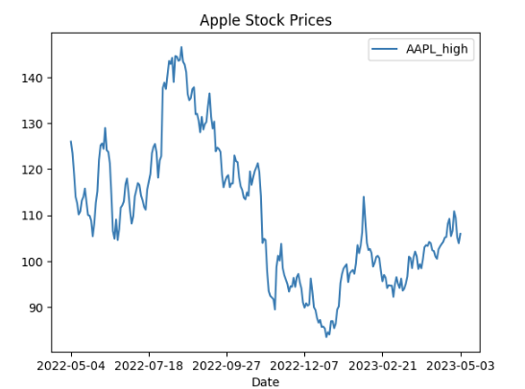
Stock Market Predictor
By Quinn Agabob

Slide 2
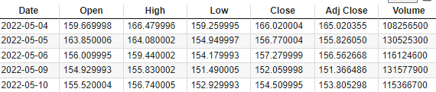
Dataset
Yahoo Finance’s historical data
Most recent data by 1 year
Columns
Date
HIgh
Low
Close
Open
Adj.Close
Volume
Stocks
Amazon(AMZN)
Apple(AAPL)
Google(GOOG)
Tesla(TSLA)

Slide 3
What I will be aiming on
I will be predicting the High of a single stock by utilizing stock market information of different stocks
Models
Linear Regression
Decision Tree Regression
Random Forest Regression
Target:
Singular High
Metric
Date
Day of week
Day of month
Day of season
Low
Volume
high(other stocks)
Close
Open

Slide 4
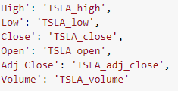
Data Engineering
Change all column name with stock data to include the name
Combine all stock data into one file
Each row is a date

Slide 5
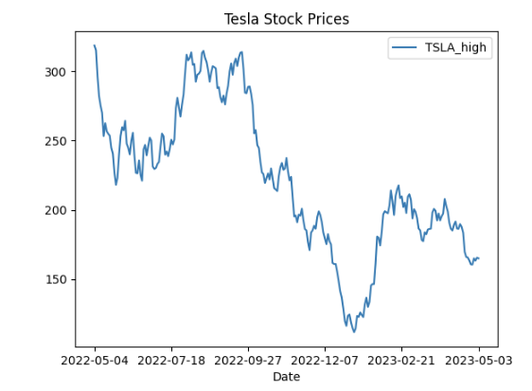
Accuracy Scores
Accuracy models
Mean Squared Error (MSE)
Root Mean Squared Error (RMSE)
Mean Absolute Error (MAE)
R-squared (R²)
The MSE, RMSE and MAE scores are based off of the distance from predicted values to actual values
R² measures if the model is a good fit for the data

Slide 6
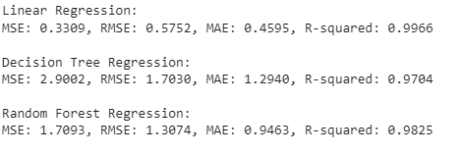
Accuracy Scores

Slide 7
Testing the model
Removed the most recent day from model
New data set of the most recent day(except for the high of stock we are predicting)

Slide 8
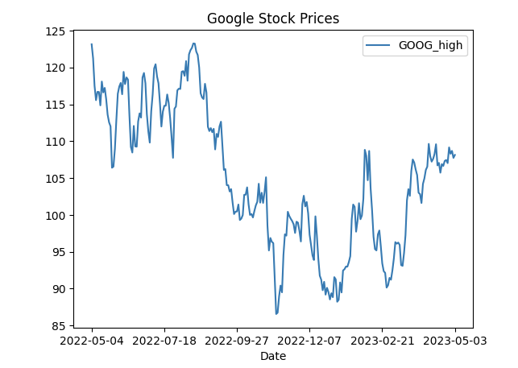
Improvements
Add in new non-stock variables
More stock data
More than just a small portfolio
Change parameters so the features are comprised of data the day before predicted target date
Alter code so it changes column names based off the name of the stock
Currently I manually made them
Change code so it web scrapes data instead of
Taking in a csv

